Slide 1
CSP Partner Overview
Windows Virtual Desktop Design

Slide 2
Windows Virtual Desktop Licensing Scenarios
Scenario | Options Researched | Recommended
Customer on dedicated Azure resources | Azure licensed via EA (old) Azure resold via CSP Azure Partner Shared Services (APSS) | Azure resold via CSP
Multiple Customers on shared Azure resources | Azure licensed via EA (old) Hosted by Right Networks in CSP Azure licensed by Right Networks -with Right Networks as the end customer- via a CSP Reseller. Azure Partner Shared Services (APSS) | Azure purchased via CSP from a CSP Reseller
Hybrid - Sensitive data Hosted by Right Networks connected to shared services (Azure via CSP resell) | Same as above | Azure resold via CSP with shared services connecting to Azure purchased via CSP from a CSP Reseller
Note:
- Windows 10 multi-session OS cannot be used for resell in an Enterprise Agreement
- Windows 10 multi-session OS is only available in CSP for resell. Meaning it cannot be used in a shared customer scenario when a single customer is not receiving the invoice for the Azure Subscription

Slide 3
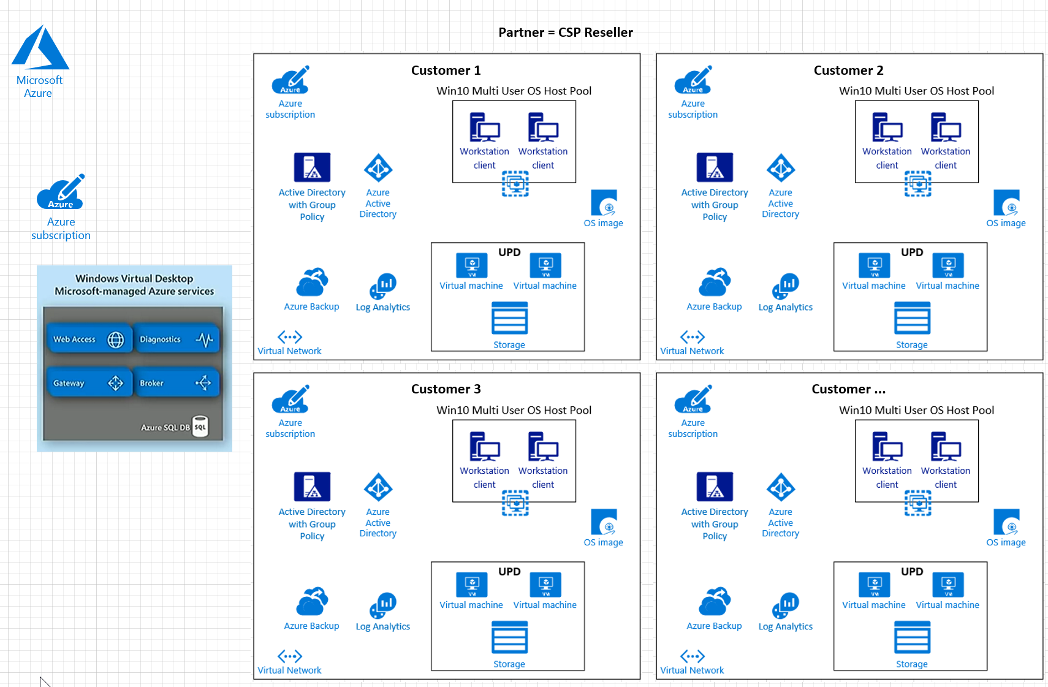

Slide 4
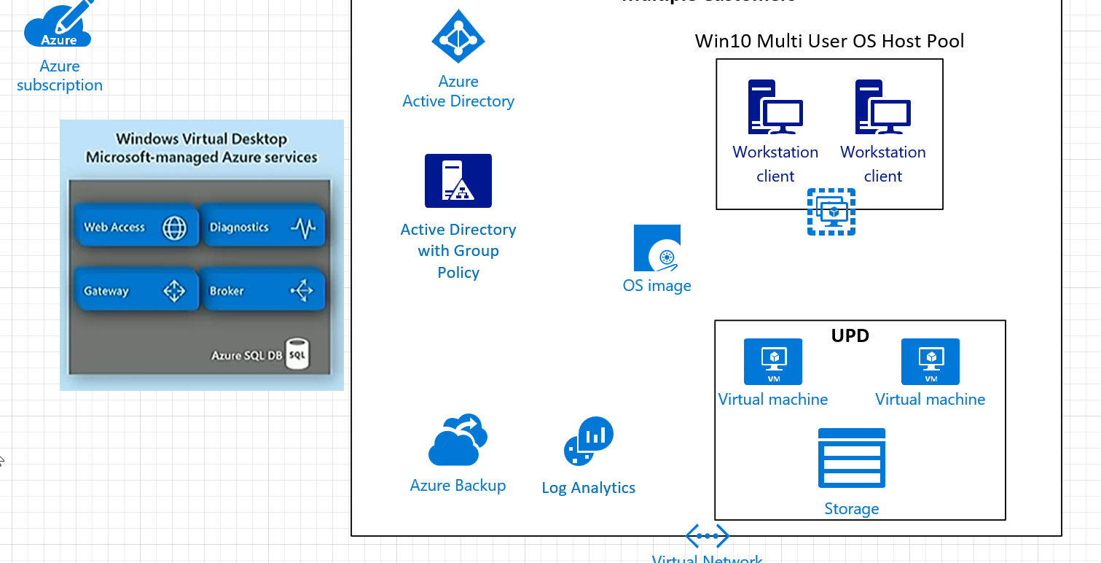

Slide 5
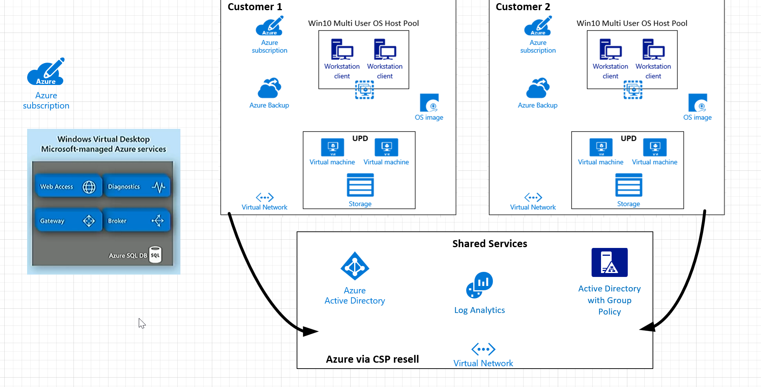

Slide 6
CSP Block Delegate Admin privileges
CSP FAQ - https://assetsprod.microsoft.com/MPN/en-us/Cloud-Solution-Provider-Frequently-Asked-Questions.pdf
What if my customer doesn’t want to provide me with data access? (E.g. finance, legal, or health companies) Although partners typically have delegated admin privileges in order to manage their customers’ subscriptions, it is not a requirement of CSP. Government or industry regulations (such as HIPAA in the USA) may require the customer to revoke delegated admin privileges so the partner cannot access sensitive data. The partner will still be responsible for supporting the customer, and may need to work out alternate means to ensure customer success. It may be appropriate for the partner to train the customer on system administration and then provide help desk support in the event the customer’s staff needs assistance. As long as the customer is satisfied with their support and does not contact Microsoft for assistance, the partner will have fulfilled their obligations under CSP
This is accomplished using a modified URL for the reseller relationship request, which looks like the following
https://businessstore.microsoft.com/manage/partner-invitation?invType=ResellerRelationship&partnerId=<the-parnter-id-here>^msppId=0&DAP=false This will create a relationship between the partner and customer, that does not have delegated admin privileges. It will have some impact on the way the partner handles integration and support. However, all that can be easily addressed using the traditional consent framework.
The API Reference is here - https://docs.microsoft.com/en-us/partner-center/develop/customers

Slide 7
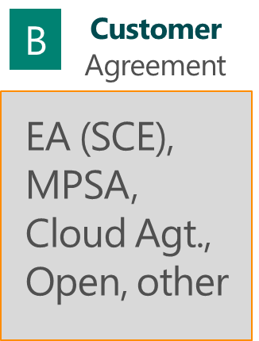

Hosting Exception – SP/ISV is the Azure tenant
The Hosting Exception allows SP’s/ISV to subscribe to Azure themselves, in support of their Customer Solution, for use by 3rd parties
Customer Solution
Azure

Slide 8
Azure licensing flow chart for partners (“you” = partner)
Are you adding a “Customer Solution”* on top of the Azure services?
Are you creating a unique Azure tenant for each individual end-customer?
You (partner) are reselling Azure (i.c.w. your Customer Solution) to your customers.
End-Customer is licensee/subscriber
YES
YES
Single-
tenant
CSP Partner (you) = Cloud Reseller.
CSP Customer has Cloud Agreement. (Alternatively, end-customer can also purchase through EA, Open, PAYGO (Azure.com).
NO
NO
You (partner) are reselling Azure to your customers. End-Customer is licensee/subscriber
You (partner) are using Azure as your DC Provider. You (partner) are the licensee/subscriber to Azure (“Hosting Exception”)
Multi-
tenant
CSP Partner (you) = Cloud Reseller.
CSP Customer has Cloud Agreement. (Alternatively, customer can also purchase through EA, Open, MPSA, etc.)
You can purchase through CSP, EA, PAYGO (Azure.com). You purchase through CSP as an end-customer from another CSP partner. You can NOT purchase Azure as a CSP Partner (Cloud reseller) for yourself.
“Customer Solution” means an application or any set of applications that adds primary and significant functionality to the Microsoft Azure Services and that is not primarily a substitute for the Microsoft Azure Services.

Slide 9
Support Options
Support provided by CSP provider
Support provided by Partner’s premier support agreement
Support provided by a combination of both Partner’s premier support agreement and the CSP provider

Slide 10
Next Steps
Onboard to WVD Private Preview
Identify CSP Provider
Build out
Infrastructure components (network, firewalls, Active Directory, Azure AD, Azure AD Connect)
Application components
Win10 multi-session image
Windows Virtual Desktop Pool
Configure Storage Space Direct / User Profile Disks / FSLogix
Pilot Users

